Slide 1
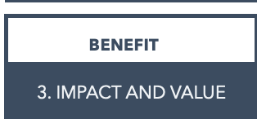
3. IMPACT AND VALUE WHAT KIND OF STAKEHOLDER VALUE?
CSR STAKEHOLDER VALUE PROPOSITIONS I TEMPLATE
Stakeholders | Demands & expectations | CSR activities (our stakeholder response) | Our added value Financial returns | Our added value Societal returns | Goals/Indicators/KPIs

