Slide 1
STRATEGY I CLEAR PURPOSE
MODULE 1
WORKBOOK

Slide 2
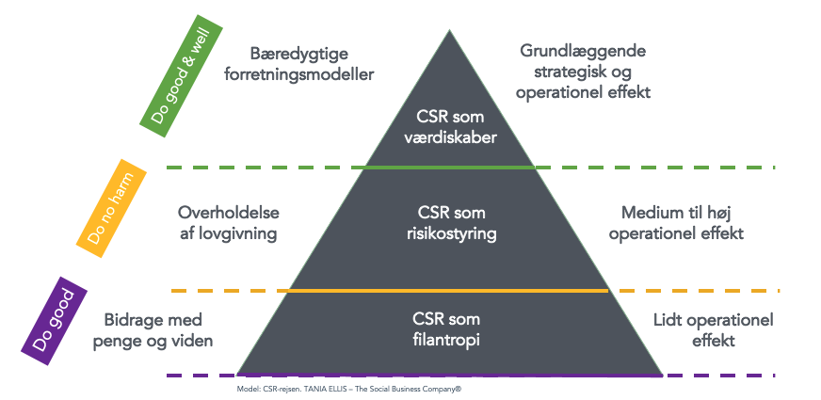
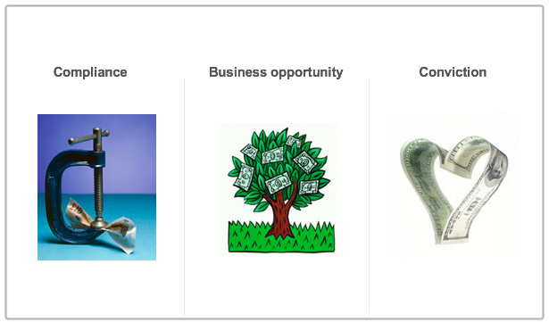
CLICK HERE FOR
EXAMPLES, TOOLS TEMPLATES https://www.sbcm-certificate.com/sustainablebusinessmindset
EXERCISE #1
Where on the sustainability journey is your company? [Hvor på bæredygtighedsrejsen er din virksomhed?]
What is the motivation / what drives your company’s work with sustainability? [Hvad er motivationen bag din virksomheds arbejde med bæredygtighed?]
INPUT FOR EXAM PAPER / ACTION PLAN 1B

Slide 3
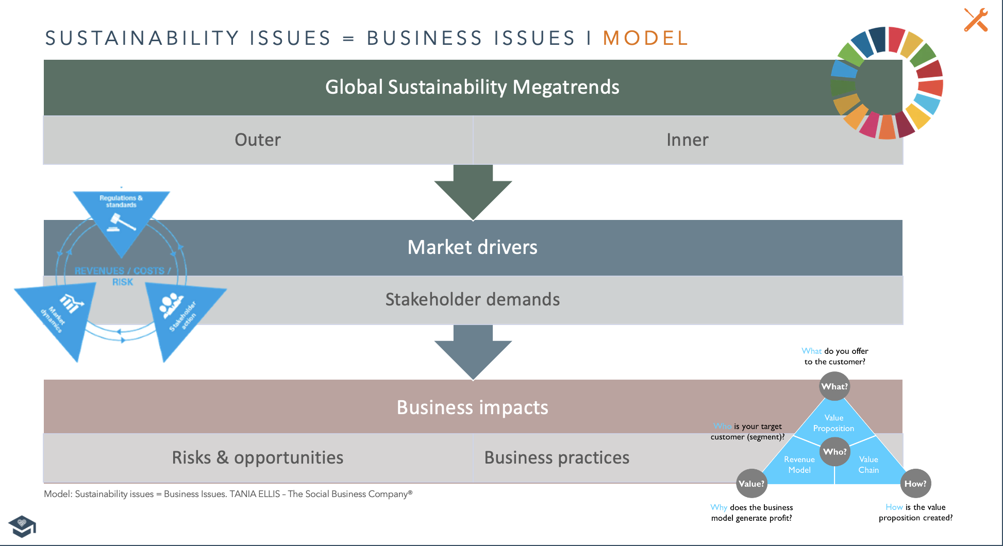
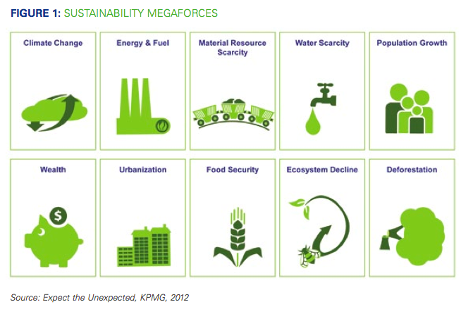
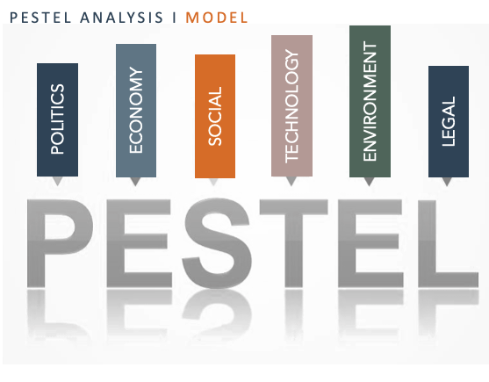
CLICK HERE FOR
TOOLS & TEMPLATES
www.sbcm-certificate.com/tools-modul1-trends-materialities
EXERCISE #2
Which megatrends and market drivers will affect your business over the next 1-5 years?
[Hvilke megatrends og markedskræfter vil påvirke din virksomhed over de næste 1-5 år?]
INPUT FOR EXAM PAPER / ACTION PLAN 1A + 6A+6B

Slide 4
USE EITHER THIS OR FIND OTHER EXAMPLES (CLICK) HERE www.sbcm-certificate.com/tools-modul1-trends-materialities
TRENDS & BUSINESS IMPLICATIONS MAP I TEMPLATE
GLOBAL SUSTAINABILITY MEGAFORCES AND TRENDS
MARKET DRIVERS & STAKEHOLDER DEMANDS
OUR BUSINESS RISKS & OPPORTUNITIES
Template: Trends & Business Implications. TANIA ELLIS – The Social Business Company®
www.sbcm-hybrid.dk/tools-modul1-trends-materialities

Slide 5
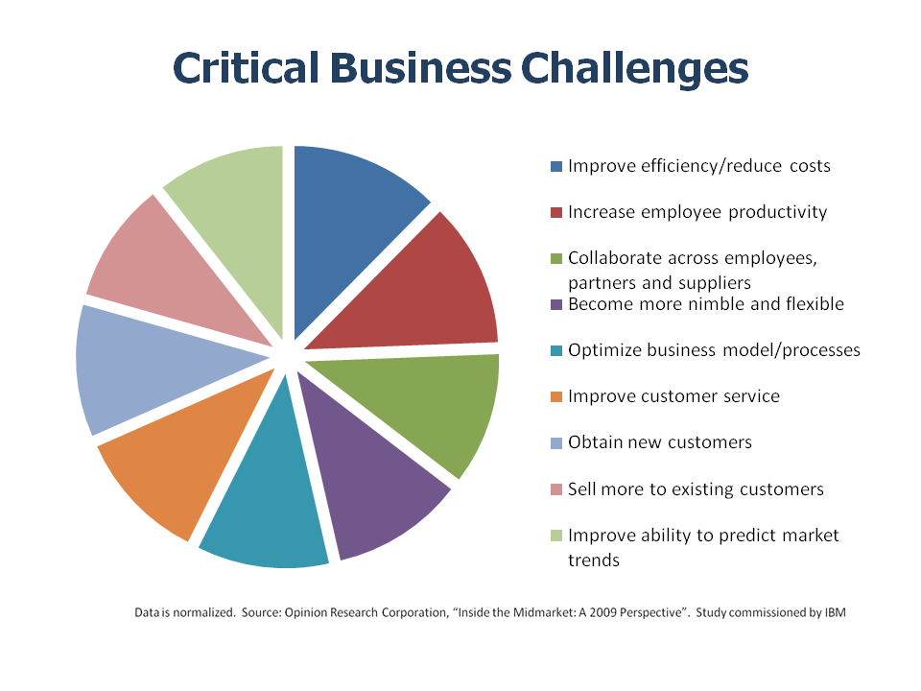
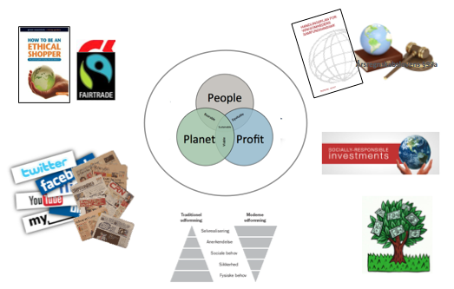
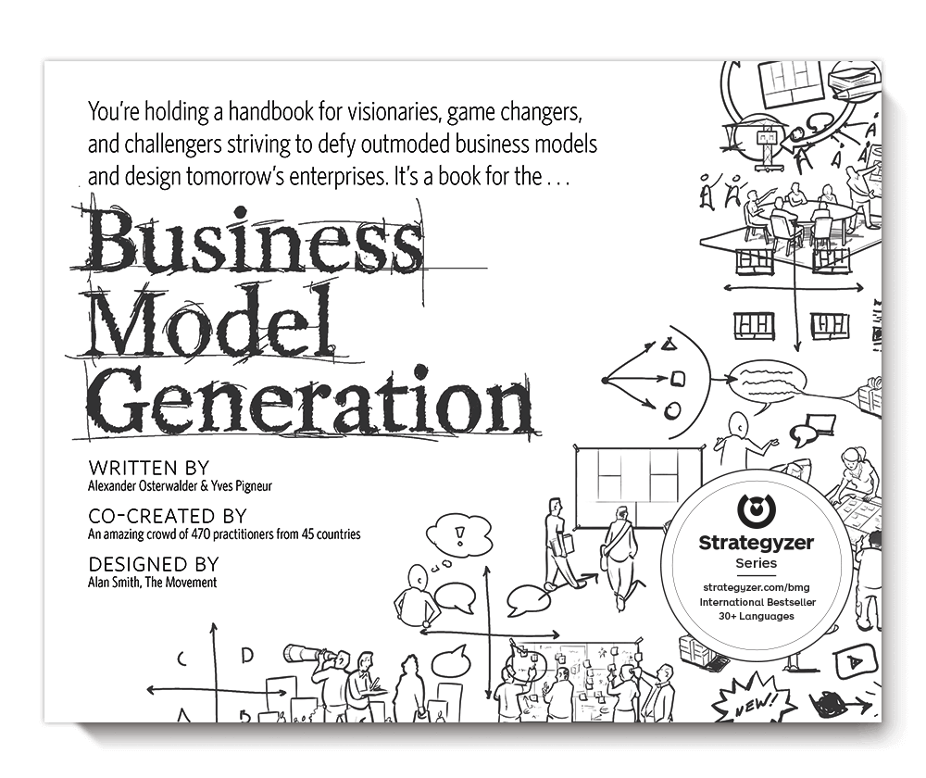
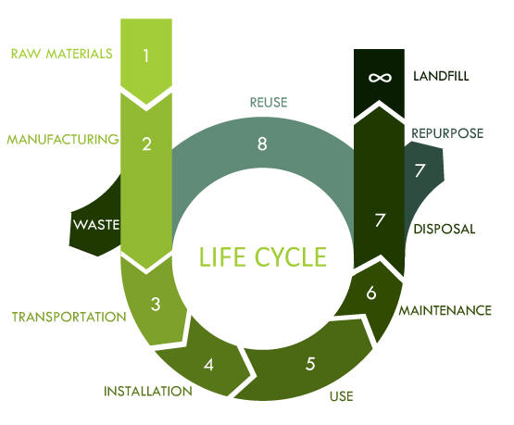
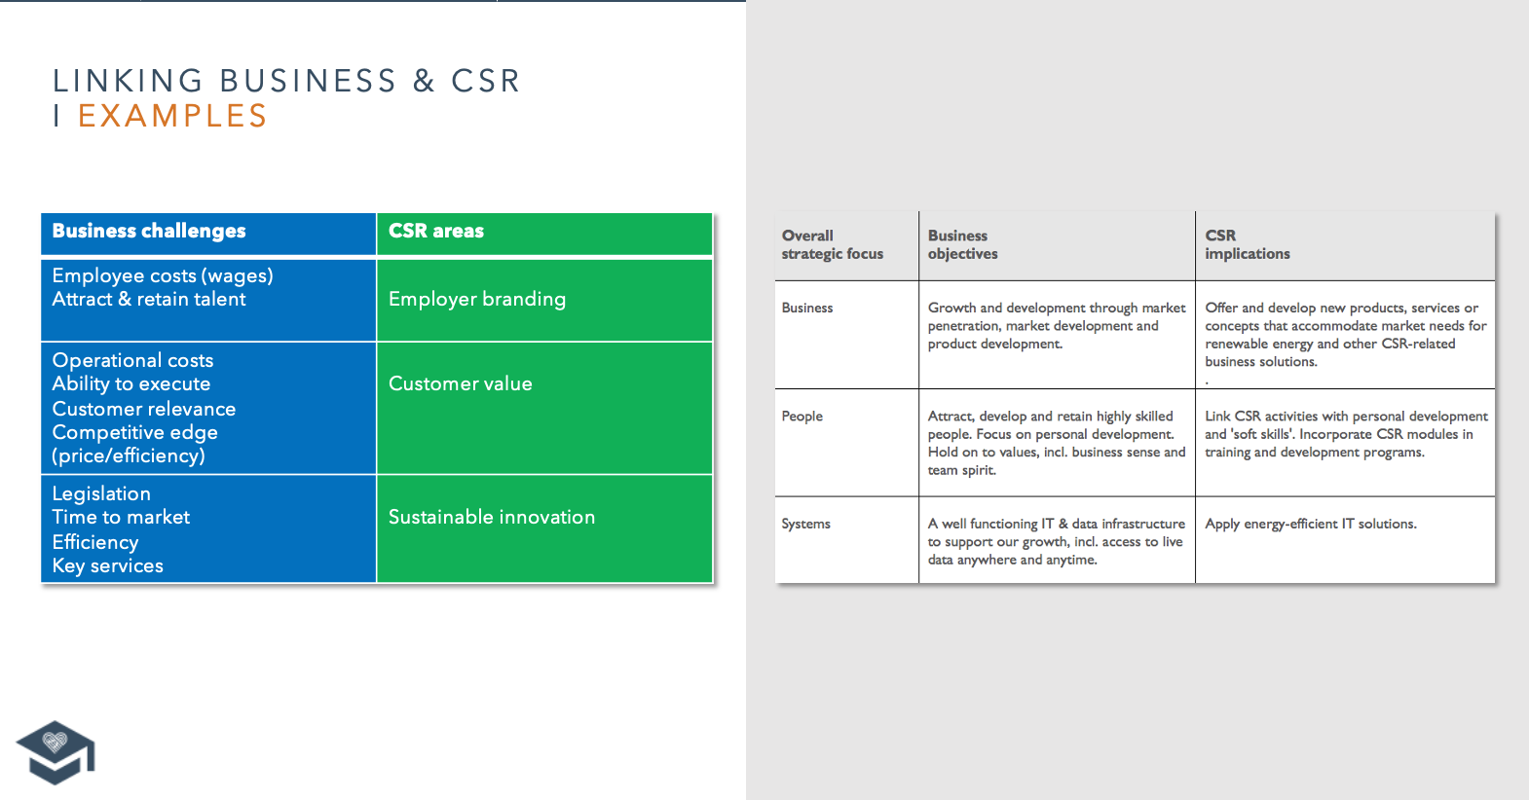
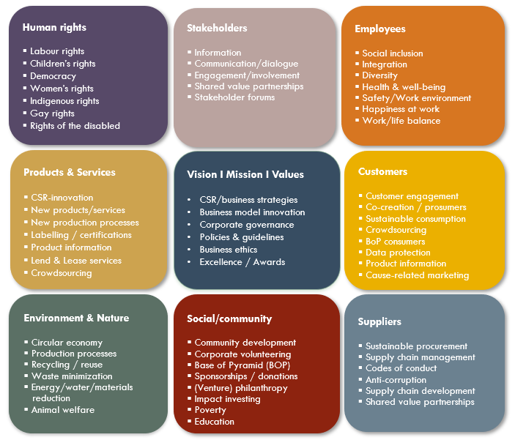
CLICK HERE FOR
TOOLS & TEMPLATES www.sbcm-certificate.com/tools-modul1-linking
EXERCISE #3*
What business challenges and/or development plans does your company have for the next 1-5 years? [Hvilke forretningsudfordringer og/eller udviklingsplaner har din virksomhed for de næste 3-5 år?]
How could CSR address/support these challenges/development plans? [Hvordan kunne CSR understøtte disse udfordringer/udviklingsplaner?]
INPUT FOR EXAM PAPER / ACTION PLAN 1A + 6A+6B
*If your company is non-commercial consider applying the outside-in approach: 1. Which societal challenges … 2. How could business support ...

Slide 6
USE EITHER THIS OR FIND OTHER EXAMPLES (CLICK) HERE www.sbcm-certificate.com/tools-modul1-linking
LINKING BUSINESS & CSR I TEMPLATE
Business challenges / development plans | Sustainable business / CSR implications

Slide 7
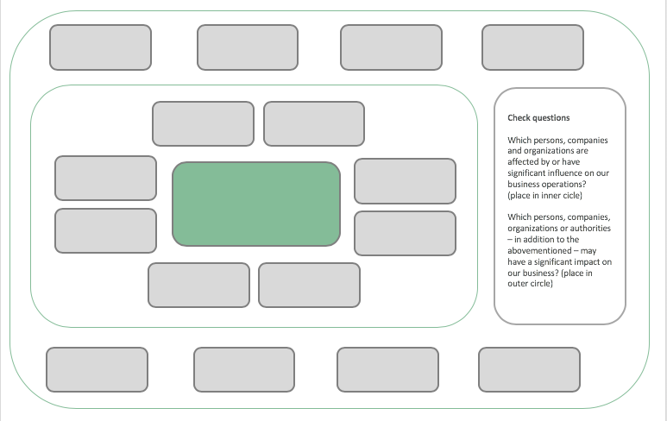
CLICK HERE FOR TOOLS & TEMPLATES www.sbcm-certificate.com/tools-modul1-stakeholders
EXERCISE #4
Who are your company’s primary and secondary
CSR/business stakeholders? [Hvem er din virksomheds primære og sekundære interessenter (forretning og CSR)?]
s. 23-28
INPUT FOR EXAM PAPER / ACTION PLAN 4A

Slide 8
STAKEHOLDER MAP I TEMPLATE
Check questions
Which persons, companies and organizations are affected by or have significant influence on our business operations?
(place in inner circle)
Which persons, companies, organizations or authorities – in addition to the above-mentioned – may have a significant impact on your business? (place in outer circle)
Model inspired by Overskud Med Omtanke, Erhvervs- og Selskabsstyrelsen, 2006
www.sbcm-hybrid.dk/tools-modul1-stakeholders

Slide 9
USE EITHER THESE OR FIND OTHER EXAMPLES: www.sbcm-certificatetools-modul1-stakeholders.com/
STAKEHOLDER RATING I TEMPLATE
High Concern / Low Influence
High Concern / High Influence
Concern
Low Concern / Low Influence
Low Concern / High Influence
Influence
www.sbcm-hybrid.dk/tools-modul1-stakeholders

Slide 10
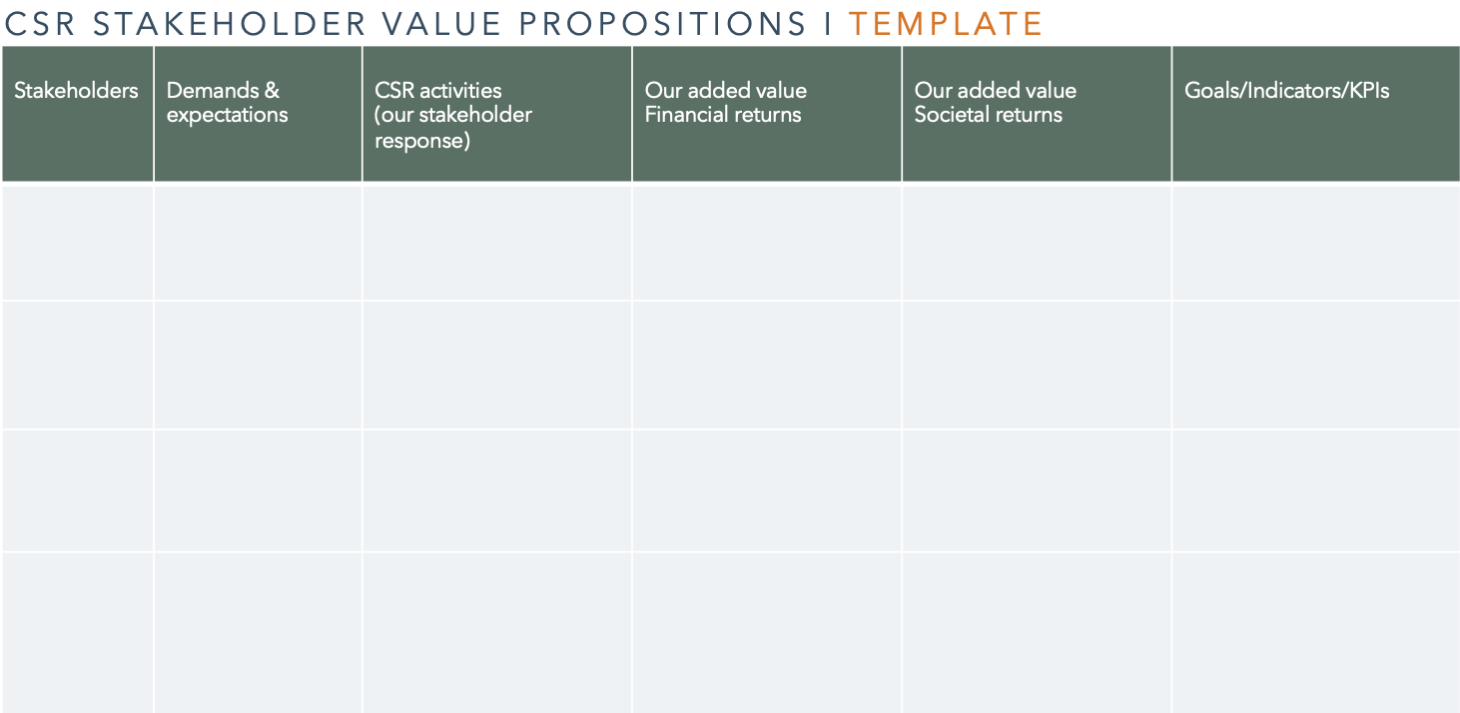
CLICK HERE FOR EXAMPLES, TOOLS & TEMPLATES www..comsbcm-certificate/tools-modul1-stakeholders
EXERCISE #5
Udvælg minimum 4 af virksomhedens nøgle-interessenter, og udfyld interessent-tabellen med:
1. Interessenternes (formodede) krav og forventninger
2. Hvilken merværdi kunne I skabe for at imødegå disse krav og forventninger.
3. Hvilke mål/indikatorer I kunne anvende til at måle på denne merværdi.
Choose minimum four key stakeholders to your company, and fill out the CSR Stakeholder Value Propositions table with your take on:
1. Stakeholder demands and expectations
2. What kind of added value you could create to accommodate to these demands and expectation.
3. Which targets/indicators could you use to measure on the added value.
INPUT FOR EXAM PAPER / ACTION PLAN 4A+B

Slide 11
DK
CSR STAKEHOLDER VALUE PROPOSITIONS I SKABELON
Interessenter | Krav & forventninger | CSR aktiviteter (vores svar på forventningerne) | Den merværdi vi skaber Økonomiske gevinster | Den merværdi vi skaber Samfundsgevinster | Mål/Indikator/KPI
CSR stakeholder value propositions. TANIA ELLIS – The Social Business Company®. Model inspired by Haisler & Holbech, CSR-ledelse, Børsens Forlag, 2008

Slide 12
CSR STAKEHOLDER VALUE PROPOSITIONS I TEMPLATE
Stakeholders | Demands & expectations | CSR activities (our stakeholder response) | Our added value Financial returns | Our added value Societal returns | Goals/Indicators/KPIs
CSR stakeholder value propositions. TANIA ELLIS – The Social Business Company®. Model inspired by Haisler & Holbech, CSR-ledelse, Børsens Forlag, 2008

Slide 13
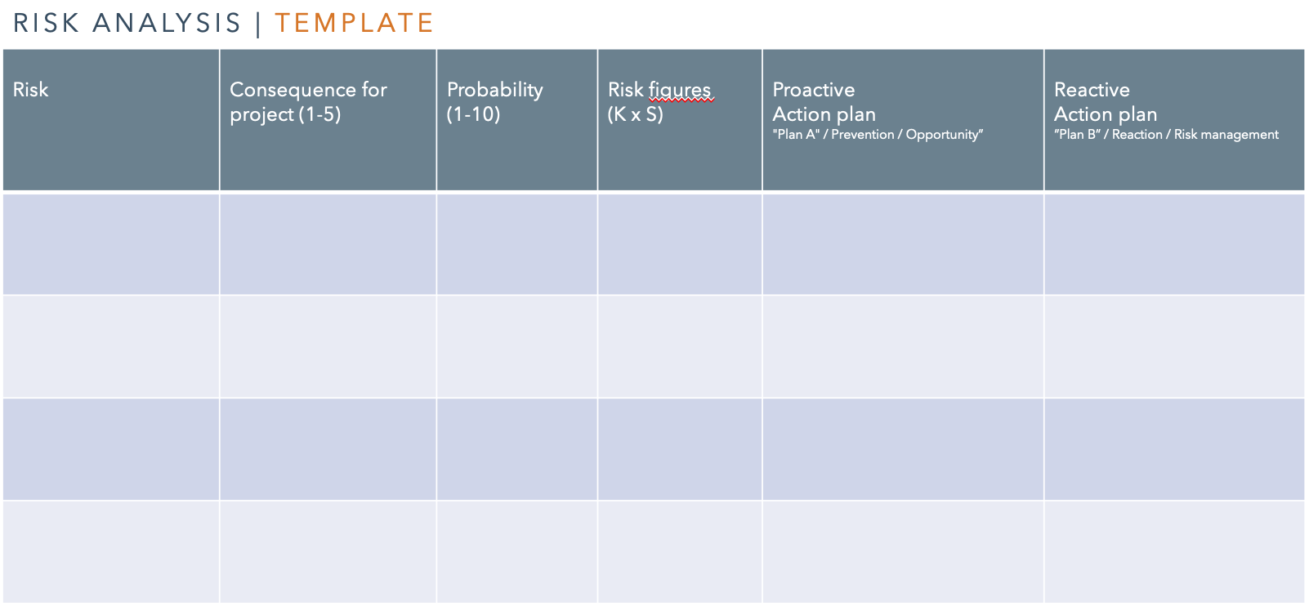
CLICK HERE
FOR EXAMPLES, TOOLS & TEMPLATES www.sbcm-certificate.com/tools-modul1-risk-opportunities
EXERCISE #6
Conduct an analysis of your company’s current or future external CSR-related risks and opportunities:
[Udarbejd en risiko- og mulighedsanalyse for jeres nuværende eller fremtidige CSR-engagement:]
Identify 3 external risks [Identificér 3 eksterne risici]
2. Suggest how to address these risks + how they could possibly be turned into opportunities [Giv et bud på hvordan disse 3 risici kunne imødegås(og eventuelt vendes til en mulighed/fordel)]
INPUT FOR EXAM PAPER / ACTION PLAN 5A + 5B

Slide 14
DK
RISIKOANALYSEN | SKABELON
Risiko | Konsekvens for projektet (1-5) | Sandsynlighed (1-10) | Risikotal (K x S) | Proaktiv Handlingsplan ”Plan A” / Forebyggelse / Mulighed | Reaktiv Handlingsplan ”Plan B” / Håndtering Risikostyring
Inspiration:Thorborg, Steen, Forandringsledelse – en grundbog.

Slide 15
RISK ANALYSIS | TEMPLATE
Risk | Consequence for project (1-5) | Probability (1-10) | Risk figures (K x S) | Reactive Action plan ”Plan B” / Reaction / Risk management | Proactive Action plan "Plan A" / Prevention / Opportunity”
Inspiration:Thorborg, Steen, Forandringsledelse – en grundbog.

Slide 16
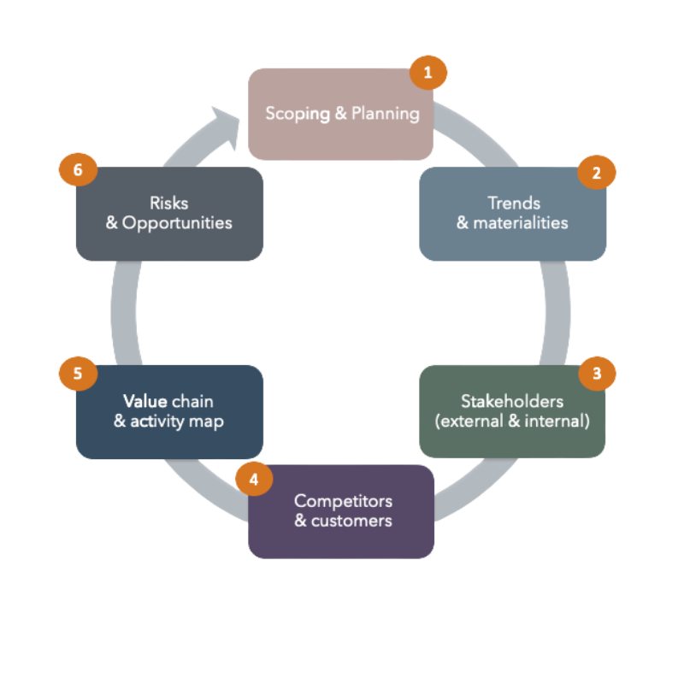
SEE NEXT PAGE FOR TOOLS & TEMPLATES
EXERCISE #7
Which analyses and reference cases could you apply in support of your business case (your argumentation) for why your company should link its business and CSR/sustainability efforts?
[Hvilke analyser + referencecases kunne du bruge til at understøtte din business case (din argumentation) for hvorfor virksomheden skal sammenkoble forretning & bæredygtighed/CSR?]
INPUT FOR EXAM PAPER / ACTION PLAN 2A + 2B

Slide 17
EXERCISE #7 – TOOLS & TEMPLATES
BUSINESS CASE
https://www.sbcm-certificate.com/tools-modul1-business-case
SCOPING & PLANNING
https://www.sbcm-certificate.com/tools-modul1-scopingplanning
TRENDS & MATERIALITIES
https://www.sbcm-certificate.com/tools-modul1-trends-materialities
STAKE-HOLDERS
https://www.sbcm-certificate.com/tools-modul1-stakeholders
COMPETITORS & CUSTOMERS
https://www.sbcm-certificate.com/tools-modul1-customers-competitors
VALUE CHAIN & ACTIVITY MAP
https://www.sbcm-certificate.com/tools-modul1-valuechain-activitymap
RISKS & OPPORTUNITIES
https://www.sbcm-certificate.com/tools-modul1-risk-opportunities

Slide 18
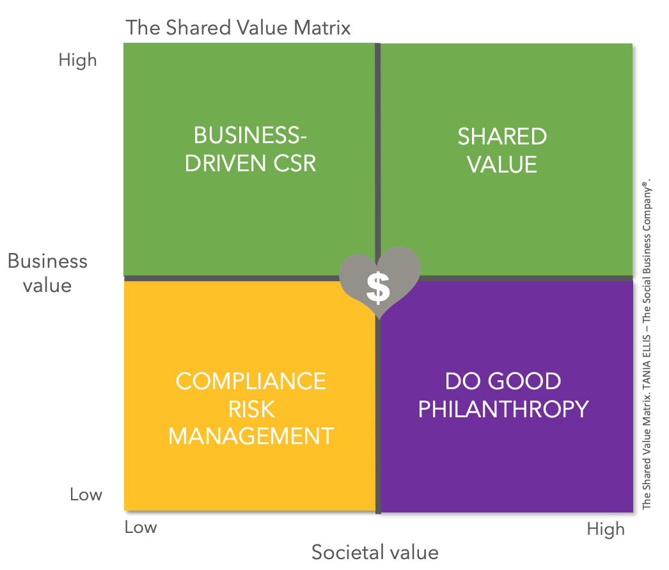
CLICK HERE FOR
TOOLS & TEMPLATES
www.sbcm-certificate.com/tools-modul1-valuechain-activitymap
EXERCISE #8
What kind of business value are your current CSR activities creating? [Hvilken form for forretningsværdi skaber/kan virksomhedens nuværende CSR-aktiviteter skabe?]
What kind of societal value are your current CSR activities creating? [Hvilken form for samfundsværdi skaber/kan virksomhedens nuværende CSR-aktiviteter skabe?
What (more) could your company do to create more ‘shared value’? [Hvad (mere) kunne virksomheden gøre for at skabe ’shared value’?]
INPUT FOR EXAM PAPER / ACTION PLAN 1A + 6A+6B

Slide 19
USE EITHER THIS OR FIND OTHER EXAMPLES (CLICK) HERE www.sbcm-certificate.com/tools-modul1-valuechain-activitymap
THE SHARED VALUE MATRIX I TEMPLATE
High
BUSINESS- DRIVEN CSR
SHARED / SYSTEMIC
VALUE
Business
value
The Shared Value Matrix. TANIA ELLIS – The Social Business Company®.
COMPLIANCE RISK MANAGEMENT
DO GOOD PHILANTHROPY
Low
Low
High
Societal value
www.sbcm-hybrid.dk/tools-modul1-valuechain-activitymap

Slide 20
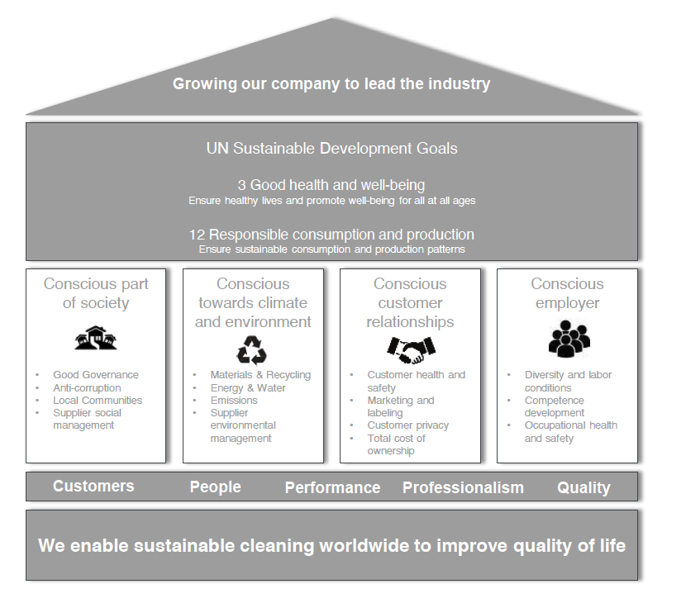
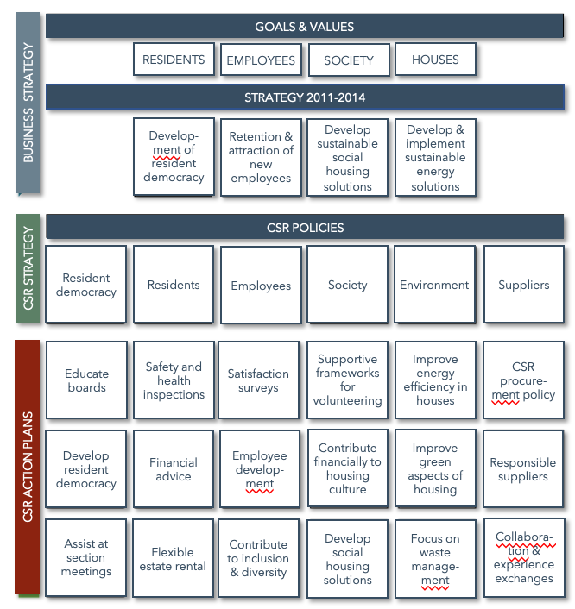
CLICK HERE FOR
TOOLS & TEMPLATES www.sbcm-certificate.com/tools-putting-it-all-together
EXERCISE #9
How could you visualize the link that you want to create between your business and CSR efforts? [Hvordan kunne du visualisere den ønskede kobling mellem virksomhedens forretning og samfundsengagement?]
INPUT FOR EXAM PAPER / ACTION PLAN 6A

Slide 21
TRY THIS TEMPLATE OR FIND INSPIRATION FOR YOUR OWN VERSION:
https://www.sbcm-certificate.com/tools-putting-it-all-together
Vision
Mission
SDGs
#1
#2
#3 -
#4 –
Strategic themes
Bizz dev.
Activities / Goals
Compliance
Values

Slide 23
TANIA ELLIS - The Social Business Company®
We inspire and help companies & professionals
create value for society and the bottom line with our:
Speaking (trends) I Club (networking) I
Academy (training) I Consulting (business development)
WWW.TANIAELLIS.COM
This presentation may not be copied, used or distributed publicly without permission.
© TANIA ELLIS – The Social Business Company®. All rights reserved.

