Slide 1
COMMUNICATION & REPORTING
MODULE 4
WORKBOOK

Slide 2
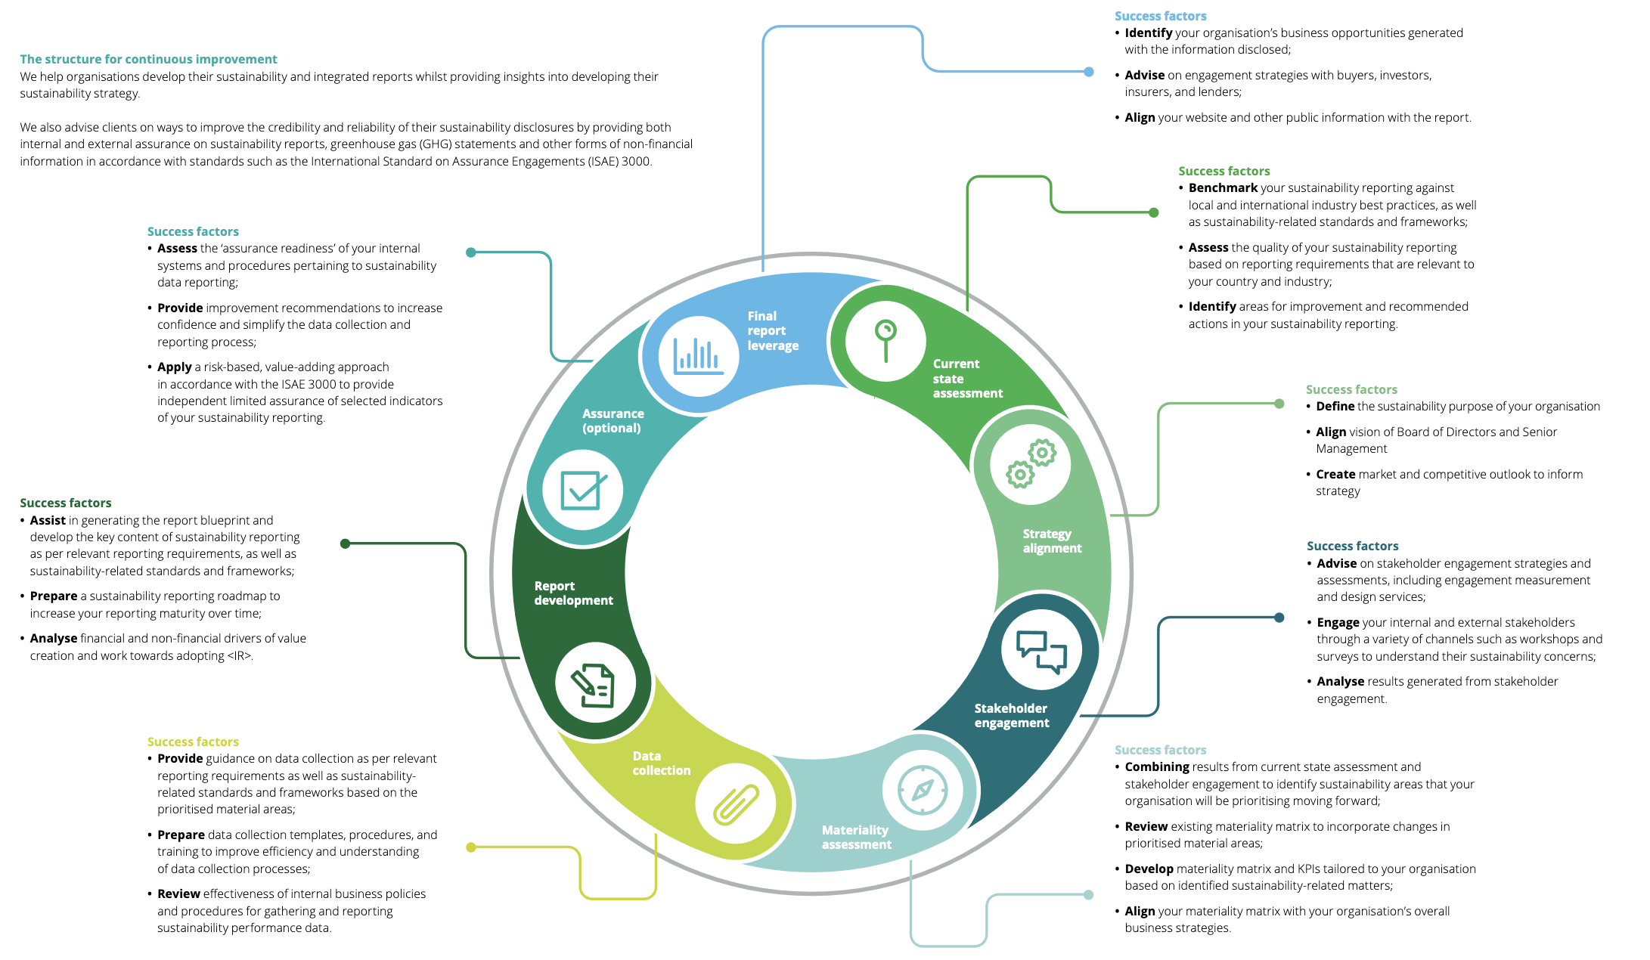
CLICK HERE FOR
TOOLS & TEMPLATES
https://www.sbcm-certificate.com/reporting
EXERCISE #1
Is your company directly or indirectly affected by legal sustainability-related reporting requirements? (e.g. CSRD, CSDDD, EUDR) [Er din virksomhed direkte eller indirekte omfattet af lovkrav til bæredygtighedsrapportering?]
What do you want to achieve from your reporting efforts? (e.g. compliance, investors, customers, branding) [Hvad ønsker I at opnå ved at rapportere? Fx compliance, investorer, kunder, branding]
What can/should you do to improve your reporting efforts? (e.g. systems, standards, processes, internal organisation, external assurance) [Hvad skal/kann I gøre for at forbedre jeres rapporteringsindsats fremadrettet?]
INPUT FOR EXAM PAPER / ACTION PAPER 9A + 9B

Slide 3
EXAMPLE OF REPORTING PROCESS
CLICK HERE FOR
GUIDES AND FULL-SIZE VERSIONS
https://www.sbcm-certificate.com/reporting

Slide 4
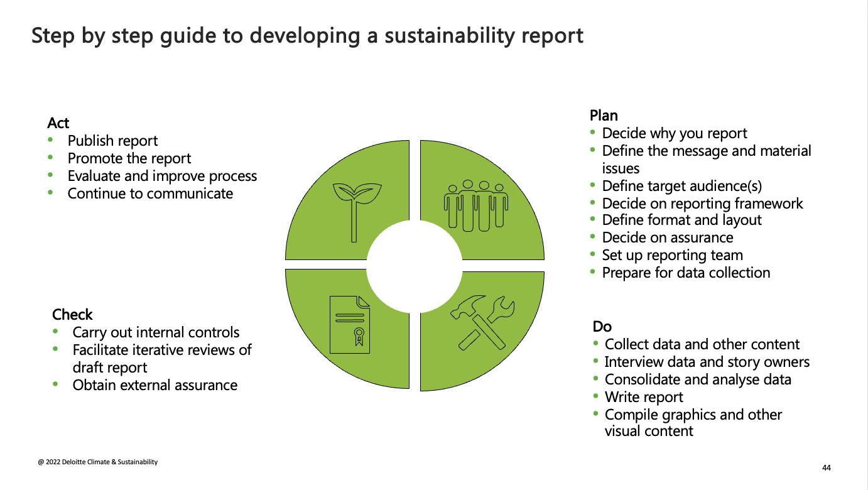
EXAMPLE OF REPORTING PROCESS
CLICK HERE FOR
GUIDES AND FULL-SIZE VERSIONS
https://www.sbcm-certificate.com/reporting

Slide 5
EXAMPLE OF REPORTING PROCESS
CLICK HERE FOR
GUIDES AND FULL-SIZE VERSIONS
https://www.sbcm-certificate.com/reporting
DK

Slide 6
EXAMPLE OF “CSRD REPORTING ORGANISATION”
Board
Top management
Steering committee
Project owner Project manager
”Sustainability partners”
Sustainability
Finance
Product
Management support
We use the RACI principle for all assignments and involved parties
Responsible
Accountable
Consulted
Informed
Risk department
Data
Internal Audit
Legal department
Procurement
Investing

Slide 7
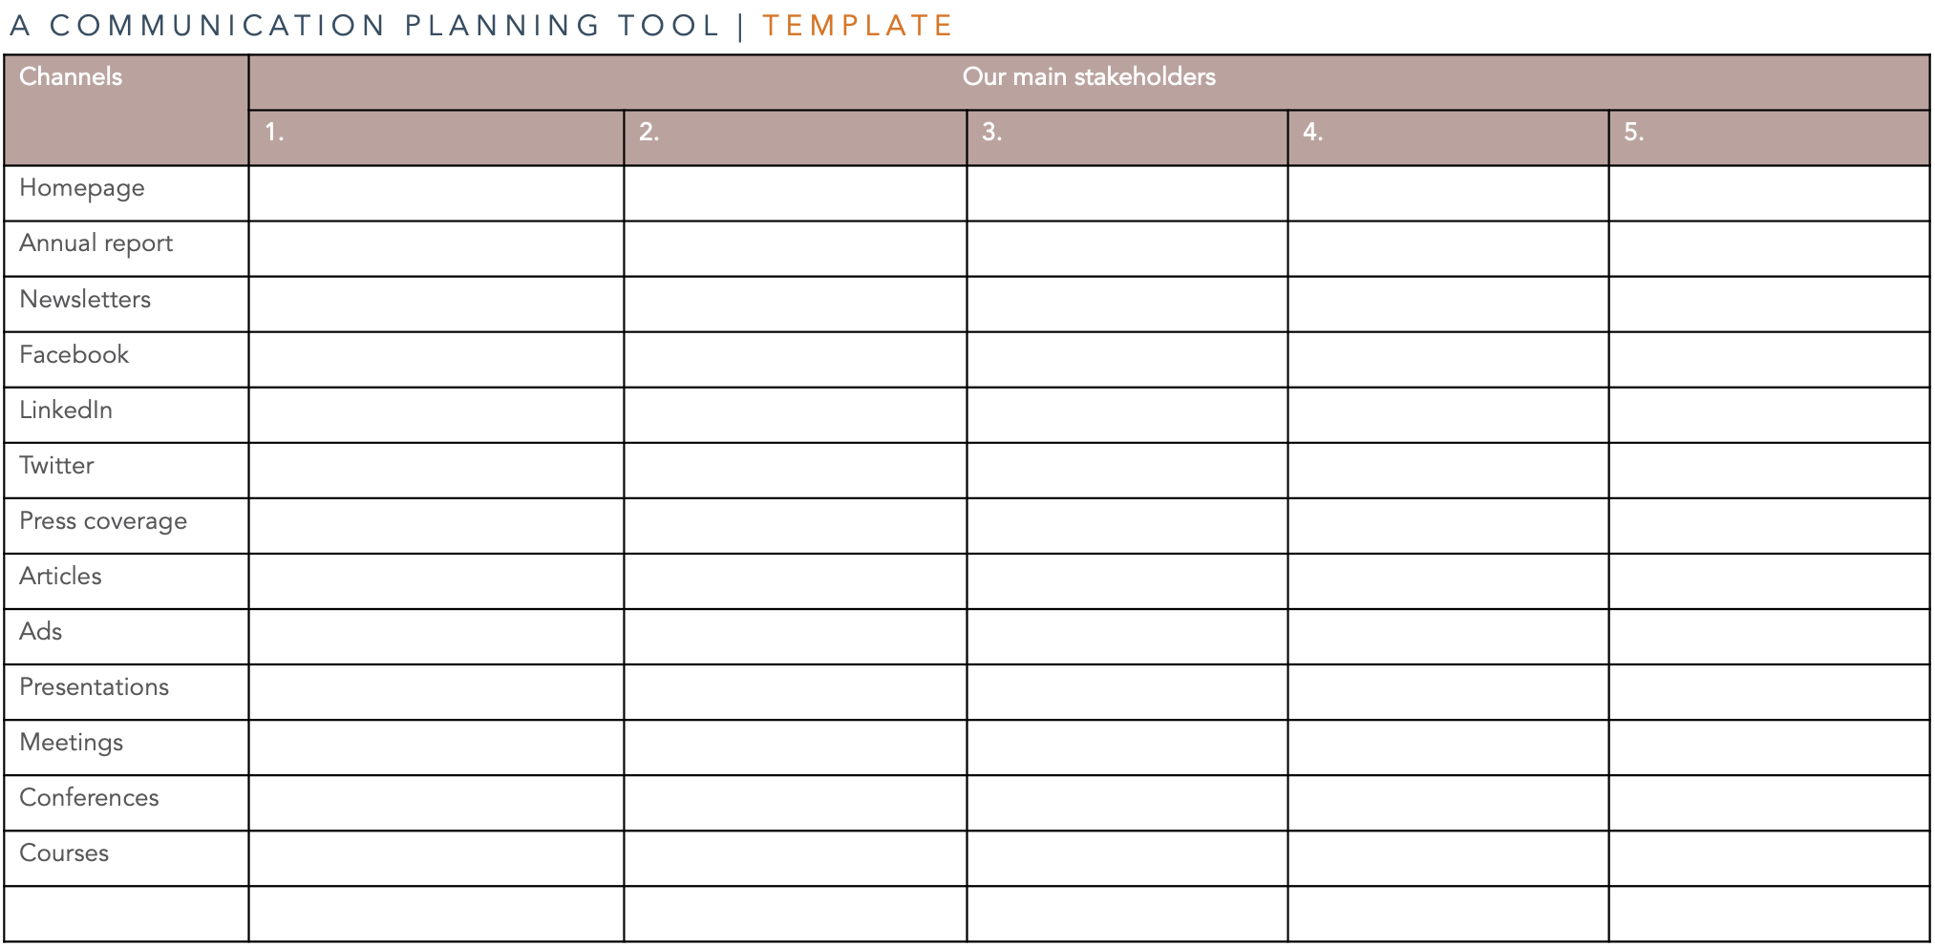
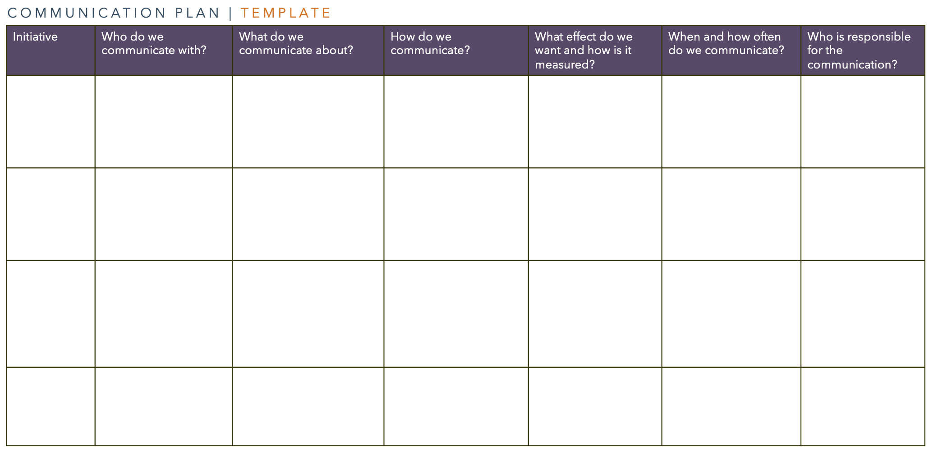
CLICK HERE FOR
TOOLS & TEMPLATES
www.sbcm-certificate.com/communicationsplanning
EXERCISE #2
At which stakeholders should my company target its CSR communication?
Which channels could be relevant to use in order to inform/communicate/engage your selected stakeholders?
Create a communication plan that includes answers to the above-mentioned questions 1 & 2.
INPUT FOR EXAM PAPER / ACTION PAPER 9A + 9B

Slide 8
KLIK HER FOR
ADGANG TIL
TOOLS & TEMPLATES
www.sbcm-certificate.com/communicationsplanning
DK
HJEMMEOPGAVE 2
Hvilke interessenter bør min virksomhed målrette sin CSR-kommunikation til?
Hvilke kanaler kunne være relevante at tage i brug for at informere/kommunikere/engagere de udvalgte interessentgrupper?
Udarbejd en kommunikationsplan, der inkluderer svarene på spørgsmål 1 & 2.
INPUT TIL EKSAMENSOPGAVE 9A + 9B

Slide 9
A COMMUNICATION PLANNING TOOL | TEMPLATE
Channels | Our main stakeholders
 | 1. | 2. | 3. | 4. | 5.
Homepage
Annual report
Newsletters
Facebook
LinkedIn
Twitter
Press coverage
Articles
Ads
Presentations
Meetings
Conferences
Courses

Slide 10
COMMUNICATION PLAN | TEMPLATE
Initiative | Who do we communicate with? | What do we communicate about? | How do we communicate? | What effect do we want and how is it measured? | When and how often do we communicate? | Who is responsible for the communication?
Translated from ”Forandringsledelse og forandringskommunikation”, Kousholt, Bjarne, 2014

Slide 11
DK
KOMMUNIKATIONSPLANEN | SKABELON
Initiativ | Hvem kommunikerer vi med? | Hvad kommunikerer vi om? | Hvordan kommunikerer vi? | Hvilken effekt ønsker vi, og hvordan måles den? | Hvornår og hvor ofte kommunikerer vi? | Hvem er ansvarlig for kommuni-kationen?
 | Interessenter (gerne personniveau) | Fx visionen Den brændende platform Effektiv kommuni-kation er fx: Enkel og forståelig Bruge billeder, analogier og eksempler Bruge mange kanaler og fora Gentage igen og igen Selv at være rollemodel Forklare uoverens-stemmelser, tilbagevise kritik | Valg af medie Fx kick-off møde Personligt brev Personlig dialog Statusmøde Telefon Nyhedsbrev Intranet Infomøde Workshop Foredrag Seminar Brochure Video Personaleblad Plakater Pressemeddelelse | Inkl. hvordan vil vi måle effekten af kommunikationen?
Kousholt, Bjarne, Forandringsledelse og forandringskommunikation, s. 403

Slide 12
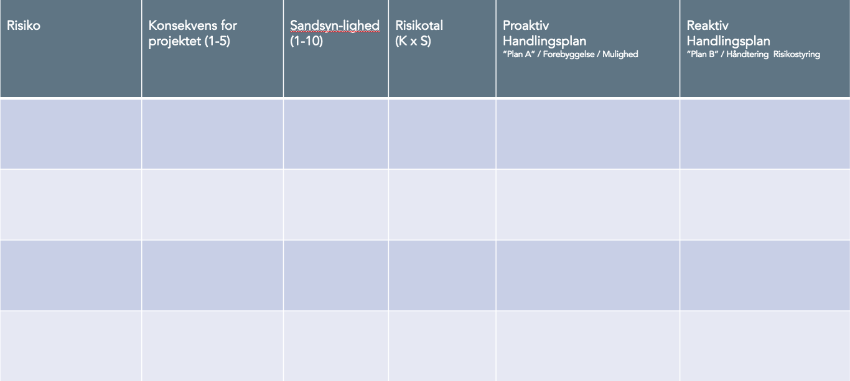
CLICK HERE FOR
TOOLS & TEMPLATES
www.sbcm-certificate.com/crisis-communication
EXERCISE #3
How could you communicate proactively about the risks and opportunities that you have identified in your external and internal risk analyses (see your Module 1 and Module 2 exercises). [If relevant, update your Plan B column]
INPUT FOR EXAM PAPER / ACTION PAPER 4A + 8A

Slide 13
KLIK HER FOR
ADGANG TIL
TOOLS & TEMPLATES
www.sbcm-certificate.com/crisis-communication
DK
HJEMMEOPGAVE 3
Hvordan kunne I kommunikere proaktivt i forhold til de risici og muligheder, du har identificeret i din eksterne og interne risikoanalyse (se dine modul 1+2 opgavebesvarelser). [Hvis relevant, opdatér din ”Plan B” kolonne]
INPUT TIL EKSAMENSOPGAVE 4A + 8A

Slide 14
DK
RISIKOANALYSEN | SKABELON
Risiko | Konsekvens for projektet (1-5) | Sandsynlighed (1-10) | Risikotal (K x S) | Proaktiv Handlingsplan ”Plan A” / Forebyggelse / Mulighed | Reaktiv Handlingsplan ”Plan B” / Håndtering Risikostyring
Inspiration:Thorborg, Steen, Forandringsledelse – en grundbog.

Slide 15
RISK ANALYSIS | TEMPLATE
Risk | Consequence for project (1-5) | Probability (1-10) | Risk figures (K x S) | Reactive Action plan ”Plan B” / Reaction / Risk management | Proactive Action plan "Plan A" / Prevention / Opportunity”
Inspiration:Thorborg, Steen, Forandringsledelse – en grundbog.

Slide 17
TANIA ELLIS - The Social Business Company®
We inspire and help companies & professionals
create value for society and the bottom line with our:
Speaking (trends) I Club (networking) I
Academy (training) I Consulting (business development)
WWW.TANIAELLIS.COM
This presentation may not be copied, used or distributed publicly without permission.
© TANIA ELLIS – The Social Business Company®. All rights reserved.

