Slide 1
ORGANISATION I CORPORATE ENGAGEMENT
MODULE 2
WORKBOOK

Slide 2
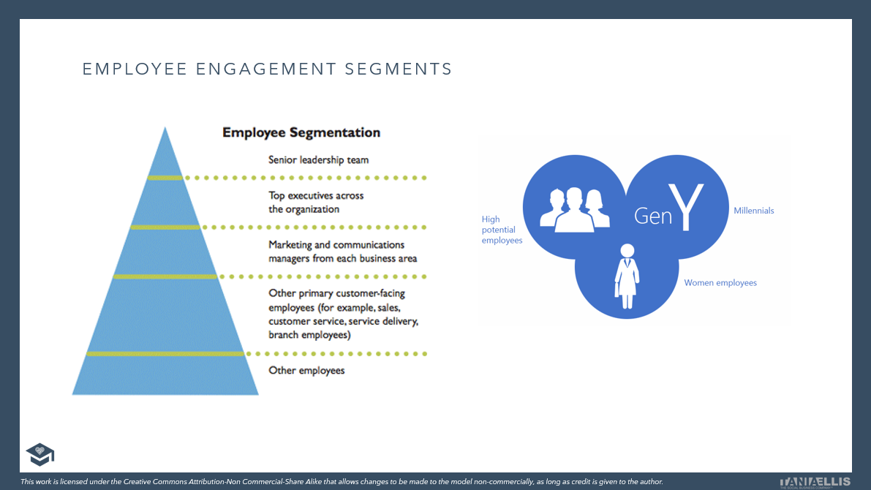
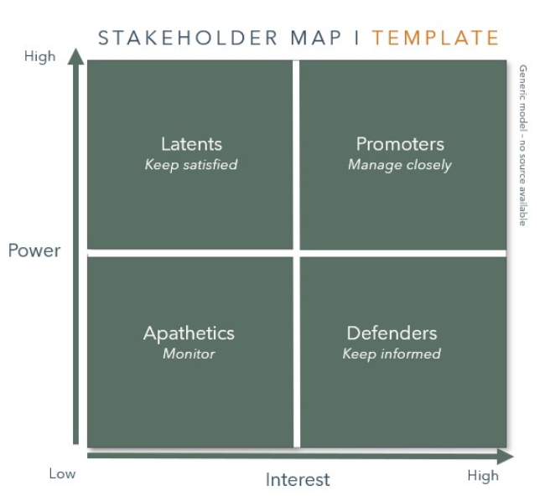
CLICK HERE FOR
EXAMPLES, TOOLS & TEMPLATES
Internal change drivers & barriers:
www.sbcm-certificate.com/change-drivers-barriers
EXERCISE #1
Who are the primary and secondary internal stakeholders to your sustainable business change plan? [Hvem er de primære og sekundære interne interessenter til CSR-forandringsprojektet?]
INPUT FOR EXAM PAPER / ACTION PLAN 4A

Slide 3
INTERNAL STAKEHOLDER MAP I TEMPLATE
Inner circle:
Which people, departments, management levels will be affected by - or can affect - my CSR change project?
Outer circle:
Which people, departments, management levels will also be affected - or can affect - my CSR change project, but to a much lesser extent, if at all?
Internal stakeholders
USE EITHER THIS OR FIND OTHER EXAMPLES:
www.sbcm-certificate.com/change-drivers-barriers
Model inspired by Overskud Med Omtanke, Erhvervs- og Selskabsstyrelsen, 2006

Slide 4
DK
INTERNE INTERESSENTER KORTLÆGNING I SKABELON
Indercirkel:
Hvilke personer, afdelinger/funktioner, ledelsesniveauer vil blive påvirket af - eller kan påvirke - mit CSR-forandringsprojekt?
Ydercirkel:
Hvilke personer, afdelinger/funktioner ledelsesniveauer vil også blive påvirket – eller kan påvirke – mit CSR-forandringsprojekt, men i meget mindre grad, hvis overhovedet?
Interne interessenter
USE EITHER THIS OR FIND OTHER EXAMPLES:
www.sbcm-certificate.com/change-drivers-barriers
Model inspired by Overskud Med Omtanke, Erhvervs- og Selskabsstyrelsen, 2006

Slide 5
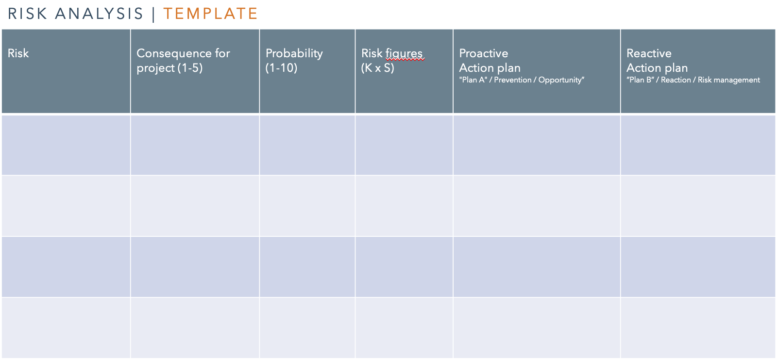
CLICK HERE FOR
EXAMPLES, TOOLS & TEMPLATES
Internal change drivers & barriers:
www.sbcm-certificate.com/change-drivers-barriers
EXERCISE #2
Conduct an analysis of your company’s current or future internal CSR-related risks and opportunities: [Udarbejd en intern risiko- og mulighedsanalyse for jeres nuværende eller fremtidige CSR-engagement:]
Identify 3 internal risks [identificér 3 interne risici]
Suggest how to address these risks + how they could possibly be turned into opportunities [Giv et bud på hvordan disse 3 risici kunne imødegås og evt. vendes til en mulighed/fordel (udfyld felter reaktiv, proaktiv handlinger]
INPUT FOR EXAM PAPER / ACTION PLAN 5AB

Slide 6
RISIKOANALYSEN | SKABELON
DK
Risiko | Konsekvens for projektet (1-5) | Sandsynlighed (1-10) | Risikotal (K x S) | Proaktiv Handlingsplan ”Plan A” / Forebyggelse / Mulighed | Reaktiv Handlingsplan ”Plan B” / Håndtering Risikostyring
Inspiration:Thorborg, Steen, Forandringsledelse – en grundbog.

Slide 7
RISK ANALYSIS | TEMPLATE
Risk | Consequence for project (1-5) | Probability (1-10) | Risk figures (K x S) | Reactive Action plan ”Plan B” / Reaction / Risk management | Proactive Action plan "Plan A" / Prevention / Opportunity”
Inspiration:Thorborg, Steen, Forandringsledelse – en grundbog.

Slide 8
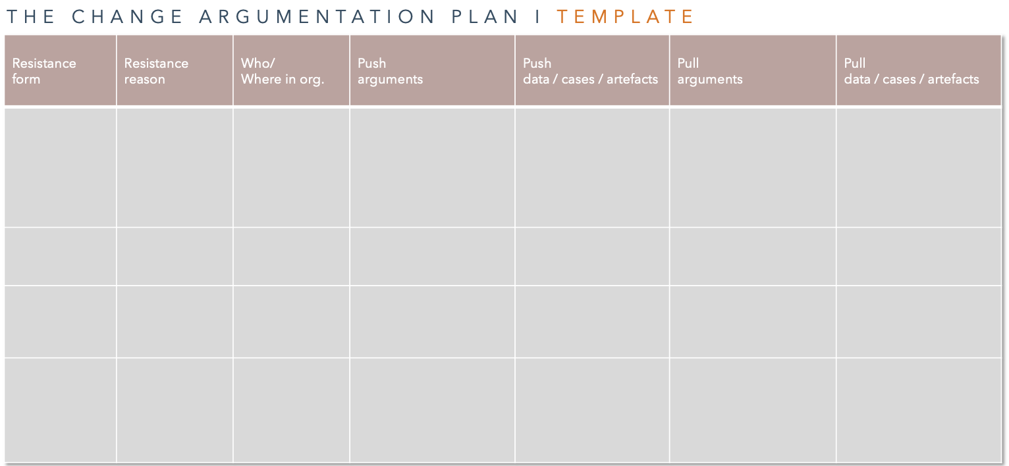
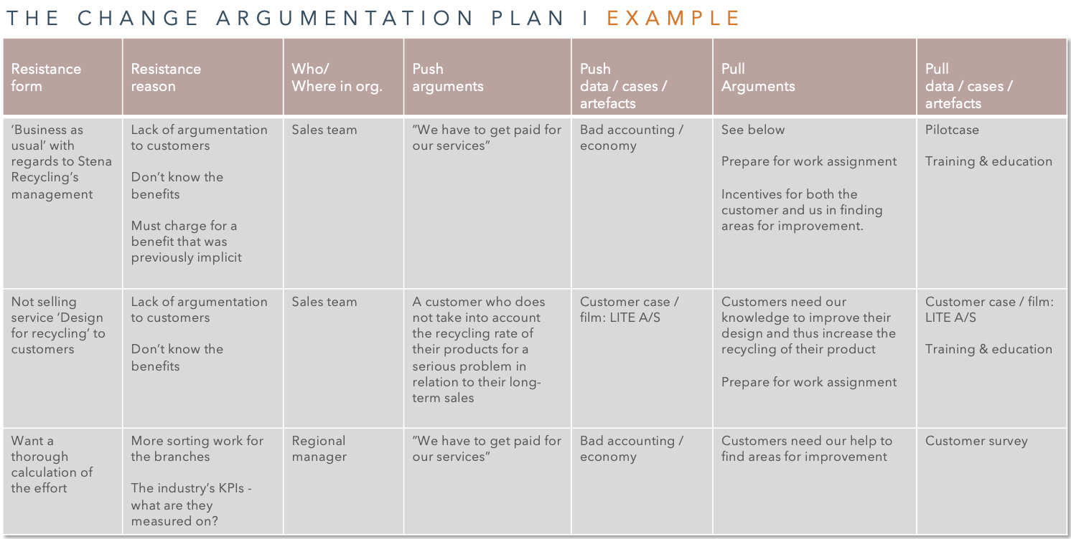
CLICK HERE FOR
EXAMPLES, TOOLS & TEMPLATES
Change strategies:
www.sbcm-certificate.com/change-strategies
EXERCISE #3
1. What kind of resistance to change can you expect from the organisation (and from whom)?
[Hvilken modstand mod forandring kan du forvente fra organisationen i forhold til at sælge CSR ind (og fra hvem)?
2. Which ”push” arguments could you apply for creating a sense of urgency? [Hvilke ”push” argumenter kunne du tage afsæt i for at skabe et "sense of urgency”?]
Which”pull” arguments could you apply for creating a positive vision for your sustainable business efforts? [Hvilke ”pull” argumenter kunne du tage afsæt i for at skabe en positiv vision
for CSR-arbejdet?]
INPUT FOR EXAM PAPER / ACTION PLAN 5AB

Slide 9
THE CHANGE ARGUMENTATION PLAN I TEMPLATE
Resistance form | Resistance reason | Who/ Where in org. | Push arguments | Push data / cases / artefacts | Pull arguments | Pull data / cases / artefacts
The Change Argumentation Plan. TANIA ELLIS – The Social Business Company®.

Slide 10
DK
THE CHANGE ARGUMENTATION PLAN I SKABELON
Modstands form | Modstands årsag | Hvem/ Hvor i org. | Push argumenter | Push data/cases/artefakter | Pull argumenter | Pull data/cases/artefakter
The Change Argumentation Plan. TANIA ELLIS – The Social Business Company®.

Slide 11
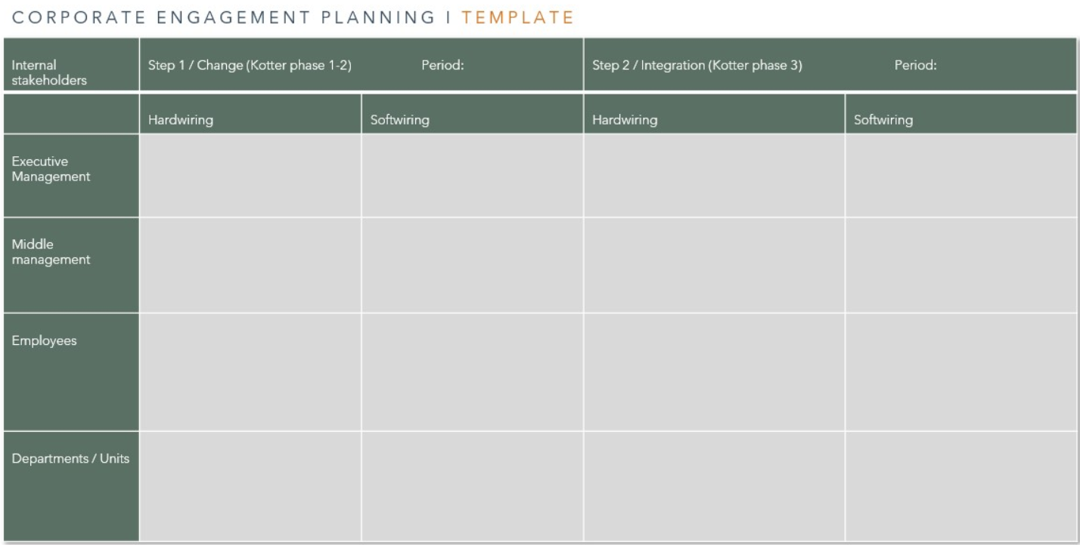
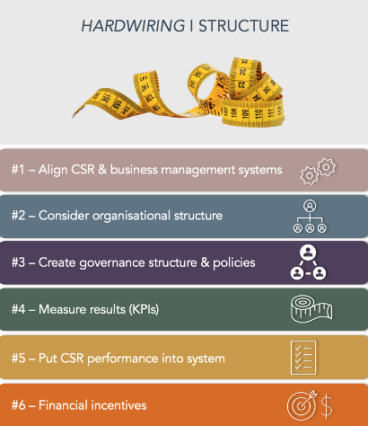
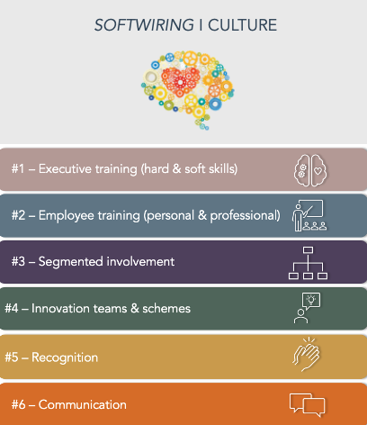
EXAMPLES, & TEMPLATES
Hardwiring:
www.sbcm-certificate.com/hardwiring
Softwiring:
www.sbcm-certificate.com/softwiring
Corporate engagement planning:
www.sbcm-certificate.com/change-strategies
EXERCISE #4
Which ”hardwiring” and ”softwiring” approaches would you apply to:
initiate and
integrate
change within your organisation?
Hvilke ”hardwiring” og ”softwiring” tiltag vil du bruge til at
a) igangsætte / gennemføre
b) forankre / integrere forandringen i din virksomhed?
INPUT FOR EXAM PAPER / ACTION PLAN 7AB

Slide 12
CORPORATE ENGAGEMENT PLANNING I TEMPLATE
Internal stakeholders | Step 1 / Change (Kotter phase 1-2) Period: |  | Step 2 / Integration (Kotter phase 3) Period:
 | Hardwiring | Softwiring | Hardwiring | Softwiring
Executive Management
Middle management
Employees
Departments / Units
Corporate Engagement Planning Template. TANIA ELLIS – The Social Business Company®

Slide 13
DK
CORPORATE ENGAGEMENT PLANNING I SKABELON
Interne interessenter | Step 1 / Forandring (Kotter fase 1-2) Periode: |  | Step 2 / Forankring (Kotter fase 3) Periode:
 | Hardwiring | Softwiring | Hardwiring | Softwiring
Ledelse
Mellemledere
Medarbejdere
Afdelinger / funktioner
Corporate Engagement Planning Template. TANIA ELLIS – The Social Business Company®

Slide 14
CLICK HERE FOR
EXAMPLES, TOOLS & TEMPLATES
Corporate engagement planning:
www.sbcm-certificate.com/change-strategies
EXERCISE #4 – TOOLS & TEMPLATES
FIND MORE BONUS INSPIRATION FROM THESE TEMPLATE EXAMPLES:

Slide 16
TANIA ELLIS - The Social Business Company®
We inspire and help companies & professionals
create value for society and the bottom line with our:
Speaking (trends) I Club (networking) I
Academy (training) I Consulting (business development)
WWW.TANIAELLIS.COM
This presentation may not be copied, used or distributed publicly without permission.
© TANIA ELLIS – The Social Business Company®. All rights reserved.

