Slide 1
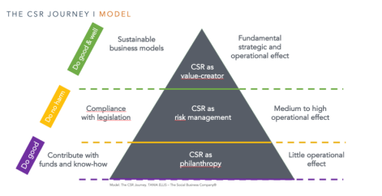
THE SHARED VALUE MATRIX I TEMPLATE
High
BUSINESS- DRIVEN CSR
SHARED / SYSTEMIC
VALUE
Business
value
The Shared Value Matrix. TANIA ELLIS – The Social Business Company®.
COMPLIANCE RISK MANAGEMENT
DO GOOD PHILANTHROPY
Low
Low
High
Societal value

