Slide 1
PARTNERSHIPS I COLLABORATIVE CO-CREATION
MODULE 3
WORKBOOK

Slide 2
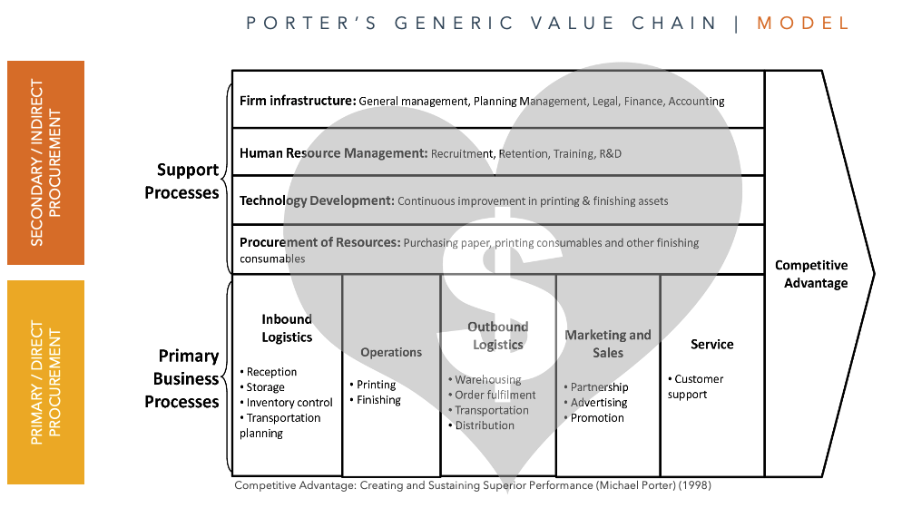
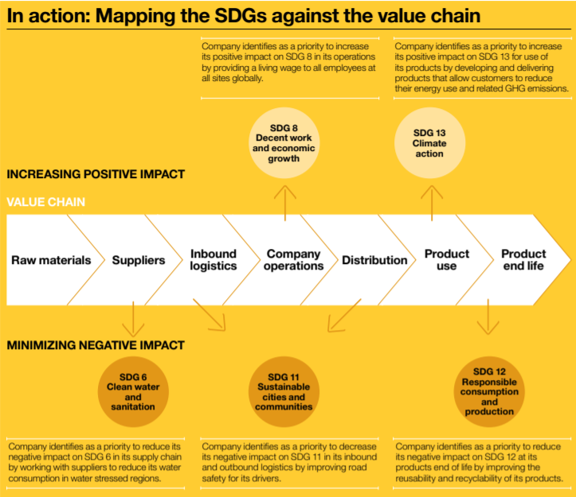
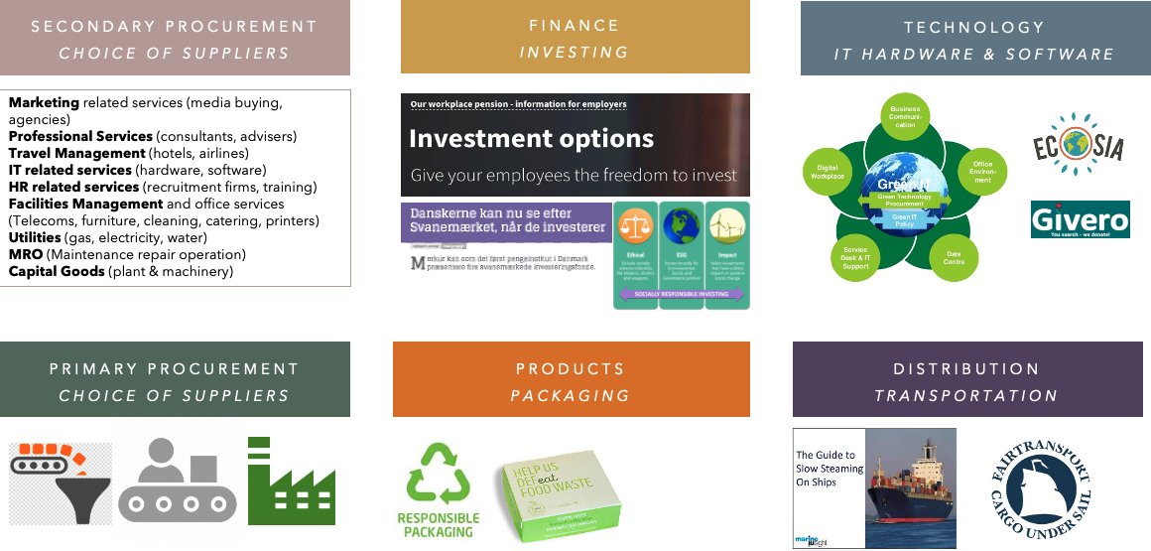
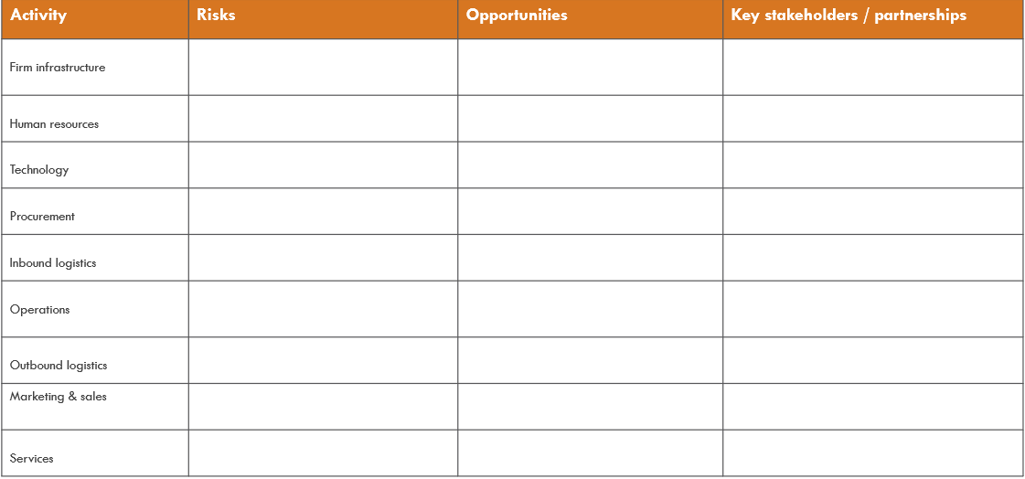
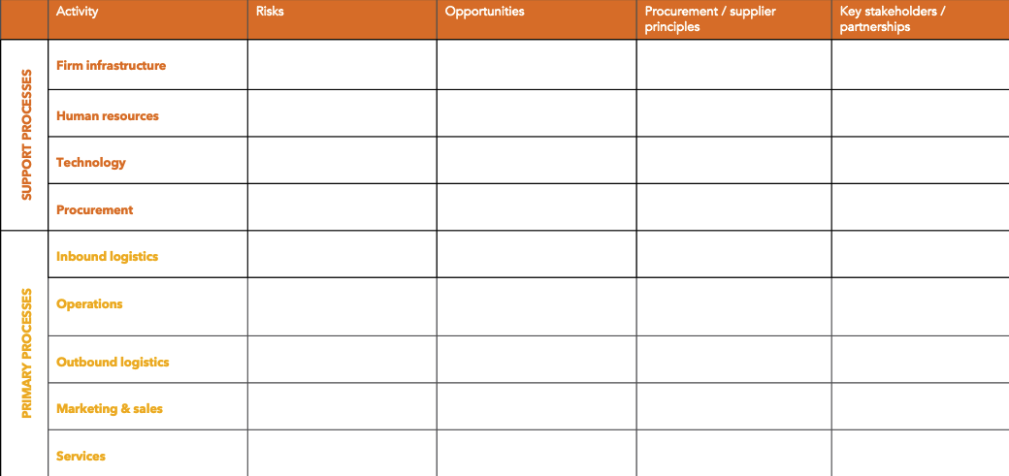
CLICK HERE FOR
EXAMPLES, TOOLS & TEMPLATES
Value chain tools & examples
www.sbcm-certificate.com/value-chain
Supply chain management
www.sbcm-certificate.com/supply-chain-management
EXERCISE #1
Which business & CSR-related risks can you identify in your company’s value chain?
Which business & CSR-related opportunities can you identify in your company’s value chain?
How could these risks & opportunities be addressed in your procurement principles and choice of suppliers?
Which stakeholders could you possibly collaborate with to address risks and/or opportunities?
INPUT FOR EXAM PAPER / ACTION PAPER 4A + 8A

Slide 3
KLIK HER FOR
ADGANG TIL
TOOLS & TEMPLATES
Value chain tools & examples
www.sbcm-certificate.com/value-chain
Procurement
www.sbcm-certificate.com/value-chain
Supply chain management
www.sbcm-certificate.com/supply-chain-management
DK
OPGAVE 1
Hvilke forretnings- og CSR-relaterede risici er der i din virksomheds værdikæde?
Hvilke forretnings- og CSR-relaterede (udviklings)muligheder er der i din virksomheds værdikæde?
(Hvordan) kunne det eventuelt afspejles i jeres indkøbspolitikker / valg af leverandører?
Hvilke interessenter i virksomhedens værdikæde kunne I eventuelt samarbejde med?
INPUT TIL EKSAMENSOPGAVE 4A + 8A

Slide 4
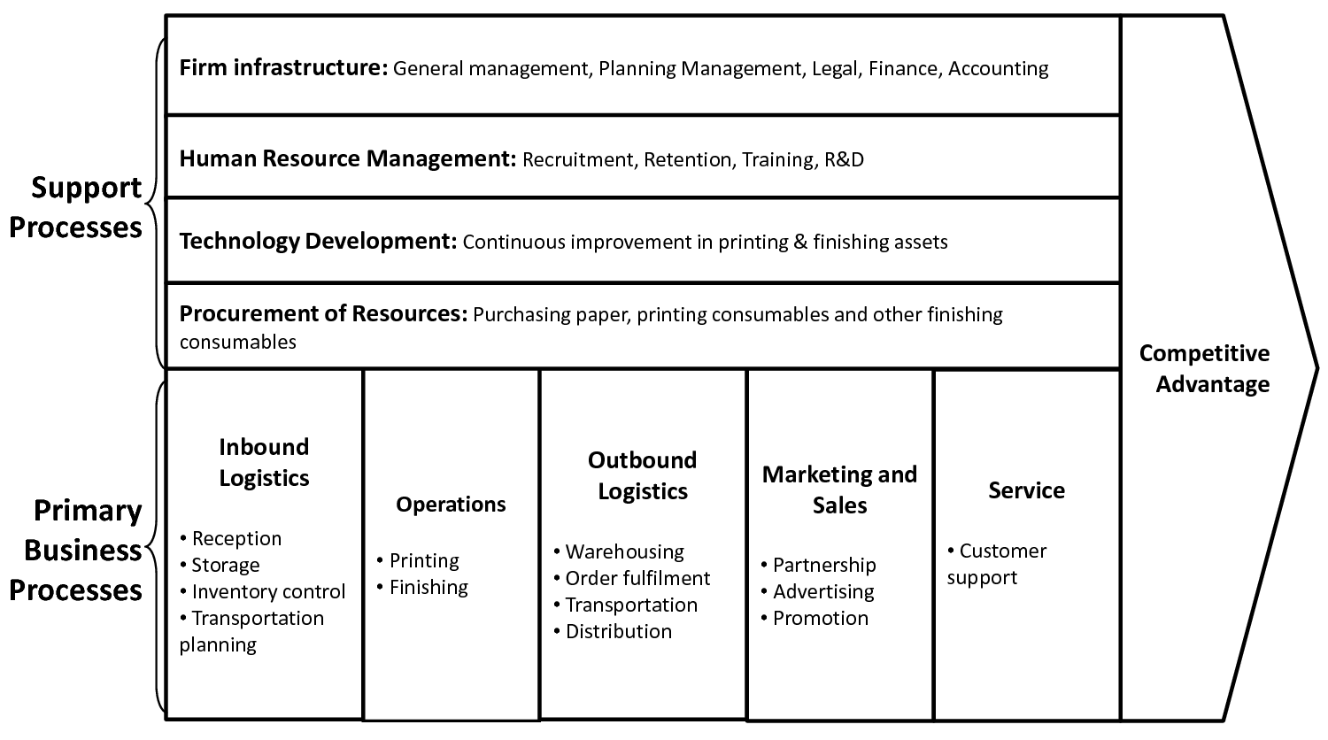
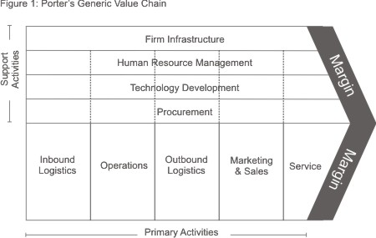
PORTER’S GENERIC VALUE CHAIN | MODEL
SECONDARY / INDIRECT PROCUREMENT
PRIMARY / DIRECT PROCUREMENT
Competitive Advantage: Creating and Sustaining Superior Performance (Michael Porter) (1998)

Slide 5
CIRCULAR AND VALUESBASED VALUE CHAIN ALLIANCES I MODEL
Hvor har vi et negativt aftryk idag? Hvor har vi et positivt?
Hvor kan vi opnå besparelser? Hvordan kan vi skabe forbedringer?
Hvem kan vi gøre det sammen med?
Company infrastructure
SUPPORT ACTIVITIES
Human resources
Product- and technology development
Business value
VALUE
ALLIANCES
Procurement / supplies
PRIMARY
ACTIVITIES
Inbound logistics
Production Operations
Outbound logistics
Marketing
& sales
Service
after sales
Societal value
Subcontractors
Suppliers
Company
Distributors
Customers
Values-based value chain alliances. TANIA ELLIS – The Social Business Company®

Slide 6
VALUE CHAIN ANALYSIS | TEMPLATE
Activity | Risks | Opportunities | Key stakeholders / partnerships
Firm infrastructure
Human resources
Technology
Procurement
Inbound logistics
Operations
Outbound logistics
Marketing & sales
Services

Slide 7
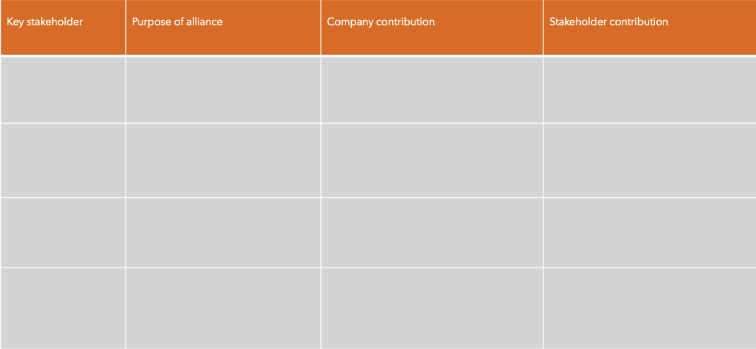
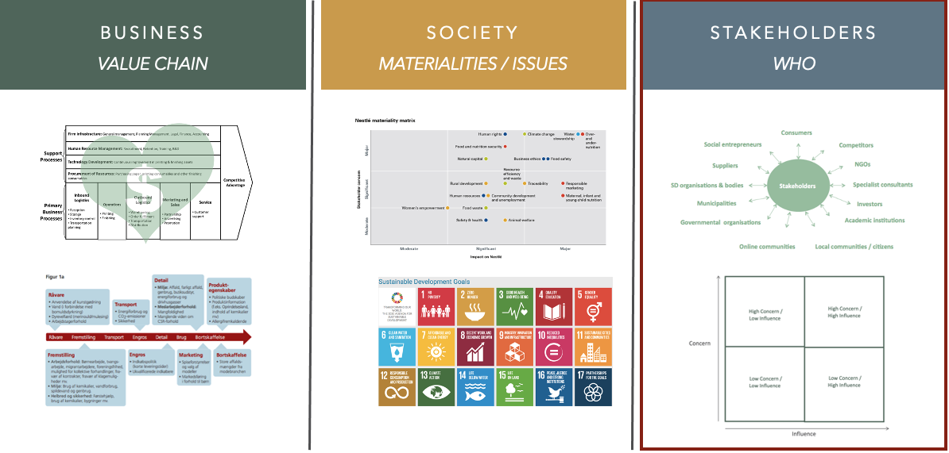
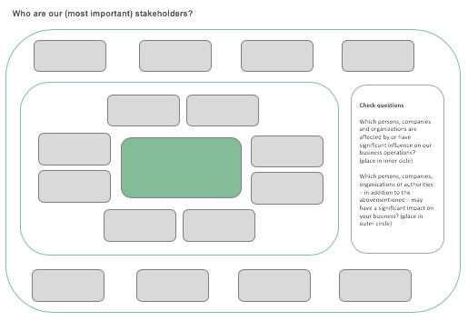
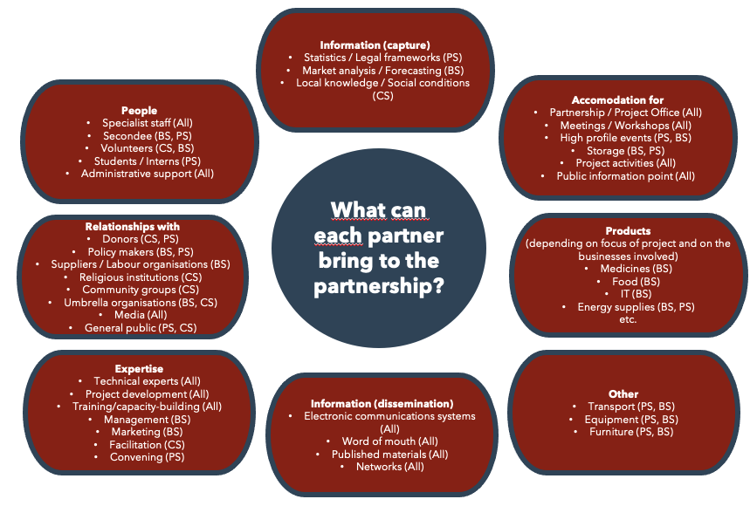
CLICK HERE FOR
EXAMPLES, TOOLS & TEMPLATES
Sustainability partnerships
www.sbcm-certificate.com/partnerships
EXERCISE #2
Which (3) key stakeholders could you collaborate with? (review your Module 1 exercise #4 & #5) [Hvilke (3) interessenter kunne det give mening for jer at samarbejde med? Tag afsæt i din besvarelse af Modul 1 opgave #4 & #5]
What should be the purpose of your alliance? (think of (S)ROIs/shared value impacts) [Hvad skulle formålet med samarbejdet være? (tænk i gevinster/værdi)]
3. What could you contribute with? [Hvad kunne I bidrage med i samarbejdet? (tænk i mere end penge)]
4. What could your stakeholder(s) contribute with? [Hvad kunne interessenten bidrage med i samarbejdet? (tænk i forretningsfordele)]
INPUT FOR EXAM PAPER / ACTION PAPER 8AB

Slide 8
PARTNERSHIP PURPOSE-CONTRIBUTION | TEMPLATE
Stakeholder | Purpose of the collaboration | The company's contribution | Stakeholder contribution
Purpose-Contribution Partnership table. TANIA ELLIS – The Social Business Company®

Slide 9
DK
FORMÅL-BIDRAG PARTNERTABEL | SKABELON
Interessentgruppe | Formål med samarbejdet | Virksomhedens bidrag | Interessentens bidrag
Formål-Bidrag Partnertabel. TANIA ELLIS – The Social Business Company®

Slide 10
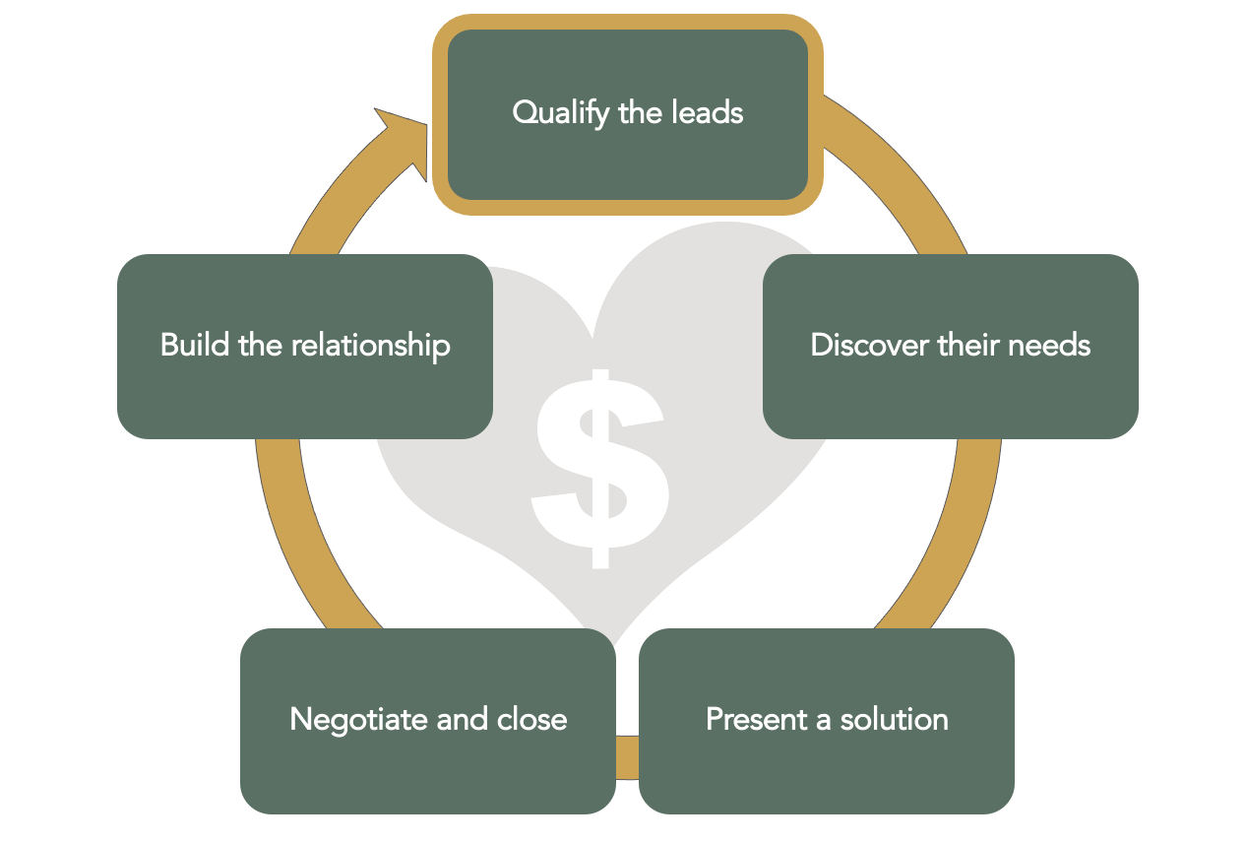
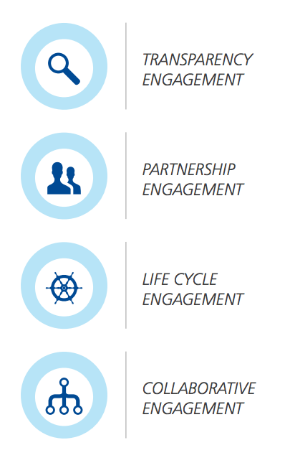
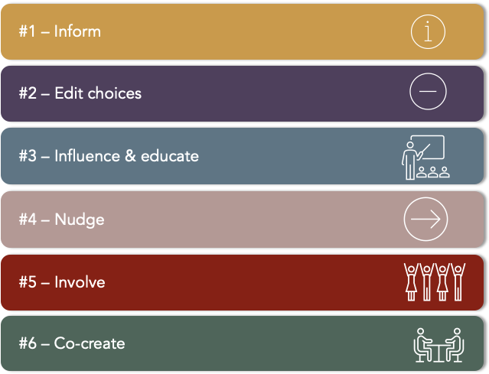
CLICK HERE FOR
EXAMPLES, TOOLS & TEMPLATES
Consumer engagement (B2C)
www.sbcm-certificate.com/consumer-engagement
Sustainability and sales (B2B, B2G)
www.sbcm-certificate.com/sustainability-sales
EXERCISE #3
What does your company already do to engage its customers in its sustainability efforts? [Hvad gør I allerede i din virksomhed for at engagere jeres kunder?]
What (more) could done – and what should the purpose of engaging customers? [Hvad kunne I (mere) gøre fremover – og hvad skulle formålet være med at engagere dem?]
How could you link or reinforce your sustainability & sales efforts? [Hvordan kobler I / kunne I koble jeres CSR-indsats til salgsfunktionen?]
INPUT FOR EXAM PAPER / ACTION PAPER 8AB

Slide 11
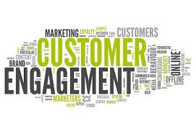
SUSTAINABLE CUSTOMER
ENGAGEMENT
PRINCIPLES
| GUIDE
#1 – Inform
#2 – Edit choices
#3 – Influence & educate
#4 – Nudge
#5 – Involve
#6 – Co-create

Slide 12
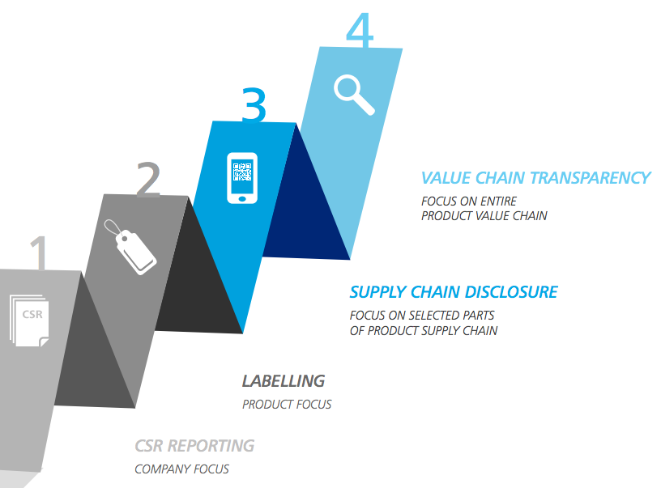
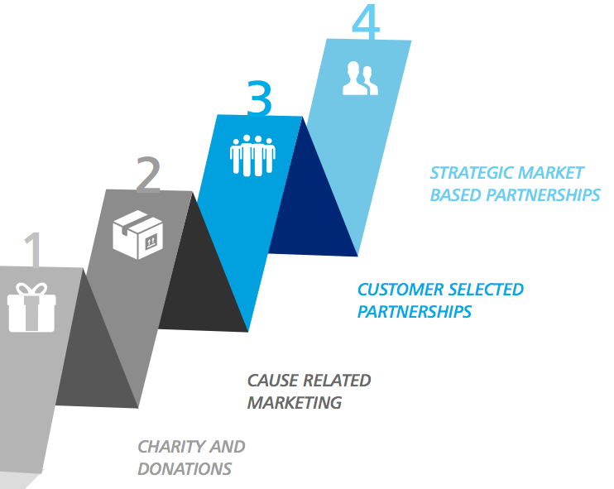
SUSTAINABLE CUSTOMER
ENGAGEMENT FRAMEWORKS | GUIDE
:
Increased customer trust and loyalty
Increased accountability
Market differentiation
Accommodate customers’ needs
Increased capitalization on donations
Access to markets
Value
proposition
Value
proposition
Make it Märkbar, Deloitte, 2014

Slide 13
SUSTAINABLE CUSTOMER
ENGAGEMENT FRAMEWORKS | GUIDE
Customer relations throughout product life cycle
Resource optimization
Market differentiation
Re-sale of products (functions sales)
Pro-longed product value
Tailored products and services in collaboration with customers
Value
proposition
Value
proposition
Make it Märkbar, Deloitte, 2014

Slide 14
THE SUSTAINABLE SALES PROCESS | GUIDE
#1 – Segment your customers
#2 – Understand your customer’s interests & needs
#3 – Relate your CSR efforts to your customer’s needs
#4 – Build value creation & impact into rewards/bonuses
#5 – Invite customers to be part of joint CSR efforts

Slide 15
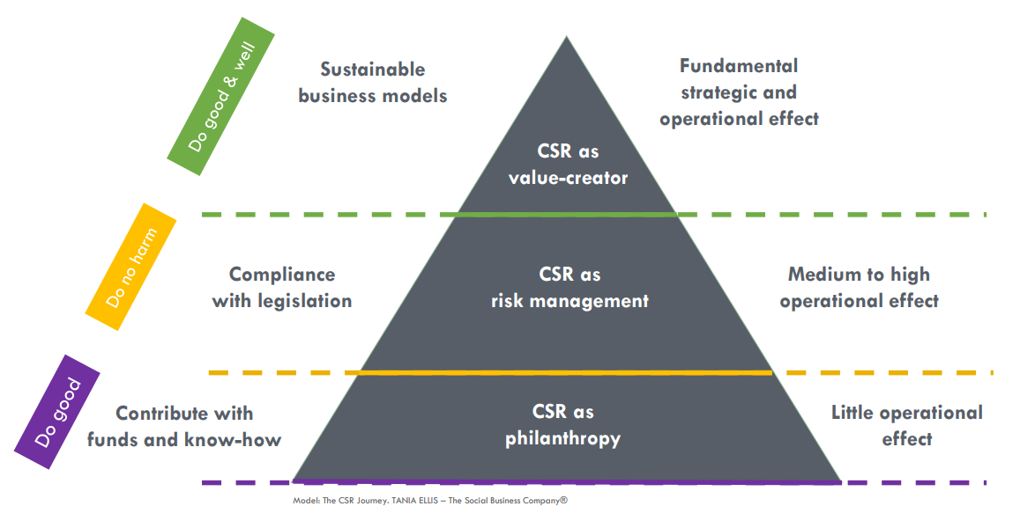
VALUE CREATING CUSTOMER
ALLIANCES I MODEL
Business – How do we create a measurable gain for the customer?
Compliance – How do we help customers to follow the regulations and norms?
Do Good – How do we help customers to do the right thing?

Slide 16
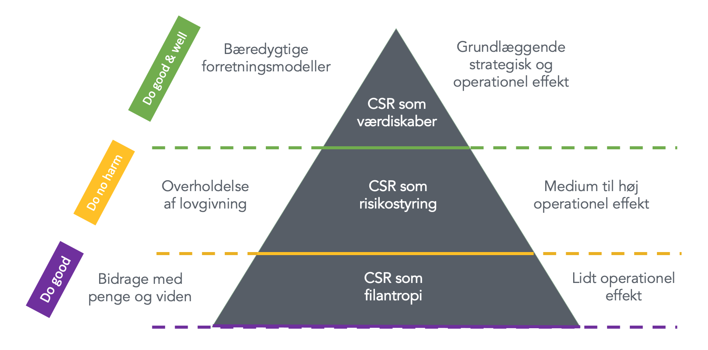
VÆRDISKABENDE KUNDEALLIANCER I GUIDE
DK
Business – Hvordan skaber vi en målelig gevinst for kunden?
Compliance – Hvordan hjælper vi kunden med at overholde regler og normer?
Do Good – Hvordan hjælper vi kunden med at gøre det gode?

Slide 18
TANIA ELLIS - The Social Business Company®
We inspire and help companies & professionals
create value for society and the bottom line with our:
Speaking (trends) I Club (networking) I
Academy (training) I Consulting (business development)
WWW.TANIAELLIS.COM
This presentation may not be copied, used or distributed publicly without permission.
© TANIA ELLIS – The Social Business Company®. All rights reserved.

